Slide 1
Physically-Based Rendering

Slide 2
Physically Based Rendering (PBR)
Modeling a more physically accurate interaction between light and surfaces
Sometimes called “Physically Based Shading” (PBS)
Not one specific implementation
Engines often handle PBR slightly differently
All have the same goals

Slide 3
PBR goals
More “realistic looking”
Ensure materials look consistent
Under different lighting conditions
Across multiple environments
Ease creation of realistic materials for artists
More consistency / predictability
Less guess work
Fewer “knobs to tweak”

Slide 4
What PBR is (and isn’t)
It’s concerned with light & surface interaction
Can be done with forward rendering
Can also be done with deferred rendering
Other effects are still used with PBR:
Normal mapping
Environment mapping
Post-process effects like AO, bloom, depth of field

Slide 5
Taking a step back
What kinds of light have we been simulating up to this point?
“Old School” rendering calculations
Diffuse
Specular
Ambient
Reflections (coming soon)

Slide 6
Old school – Direct light
Light coming directly from light sources
Diffuse
Light that hits surface and reflects in all directions
A “diffusion” of light
Specular
Light that hits surface and reflects at the viewer
The “reflection” of the light source

Slide 7
Old school – Indirect light
Light coming in from the environment
Ambient
Omnipresent, omnidirectional light
Fakes light “bouncing around”
A poor man’s global illumination
Reflections
A mirror-like reflection of the world around us
Shiny objects usually reflect the world too

Slide 8
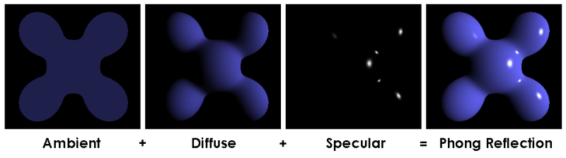
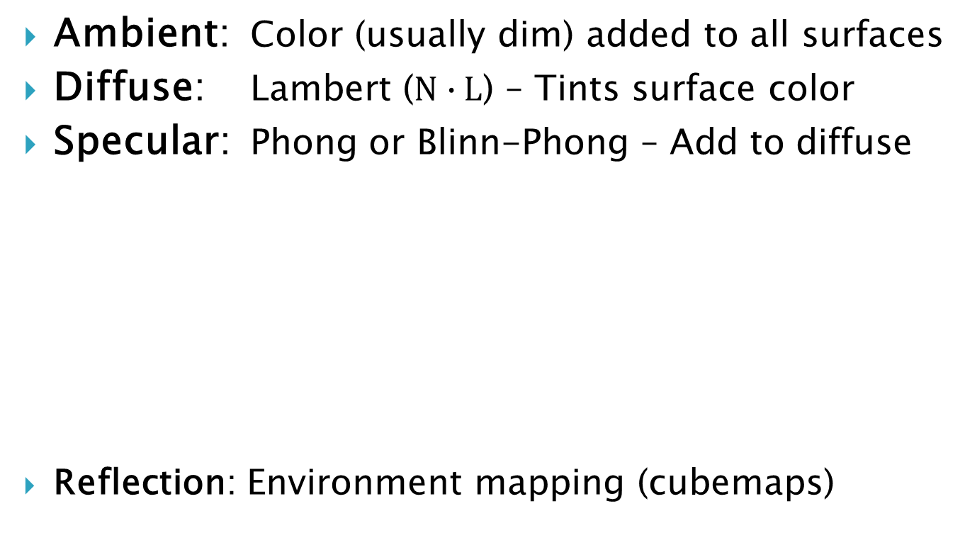
Old school – Light equations
Ambient: Color (usually dim) added to all surfaces
Diffuse: Lambert (N $∙$ L) – Tints surface color
Specular: Phong or Blinn-Phong – Add to diffuse
Reflection: Environment mapping (cubemaps)

Slide 9
Old school – Light sources
Uses punctual light sources
“Pertaining to or of the nature of a point”
No perfect real-world analogs, but the math is fast!
Directional Light
Simulates an infinitely big “wall of light”
Decent for simulating main light source (often sun)
Point Light – Similar to a light bulb
Spot Light – Like a flash light

Slide 10
Old school – Surface materials
Surface (diffuse) color
Color of the surface under 100% white light
Often other effects baked in, like ambient occlusion
Specular (gloss) map
How “reflective” the surface is, per pixel
Potentially RGB texture for colored reflections
Normal map

Slide 11
Old school issues - Energy
Objects are unnaturally bright
Ambient + Diffuse + Specular?
Too much light!
A surface can’t reflect more light (energy) than it receives
Law of conservation of energy
Technically reflects less - some turns into heat
(But that’s mostly irrelevant to us)

Slide 12
Old school issues – Asset creation
Artists have many “knobs” to tweak
Ambient & diffuse color, reflectivity, specularity, etc
Can be time consuming to get it all correct
Lots of guesswork
Often tweaked for a certain environment
Great “daytime” material != great “night” material
Breaking the laws of physics
Finally lighting usually physically inaccurate
Unless artists are doing math

Slide 13
PBR to the rescue!
PBR reduces the impact of these issues:
More accurate lighting on objects
More realistic materials
Predictable workflow for artists
Still uses punctual light sources
Because the math is fast
And they mostly do what we need
Some engines support real-time area lights

Slide 14
What makes up PBR?
Bidirectional Reflectance Distribution Functions
Microfacet theory
Fresnel term
Image-Based Lighting
Energy conservation
Real-World Material Parameters

Slide 15
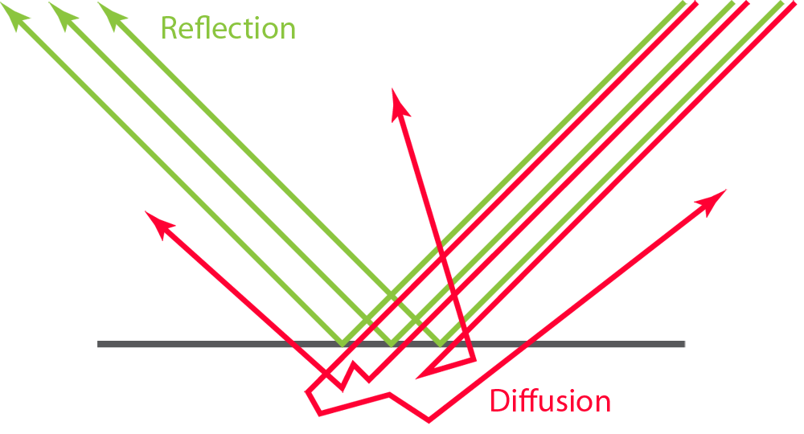
Diffusion & reflection
Diffusion – Light scattering
Reflection – Light bouncing
Need functions to calculate:
How light diffuses
How light reflects
Also need to define surface color (albedo)
And incoming light color

Slide 16
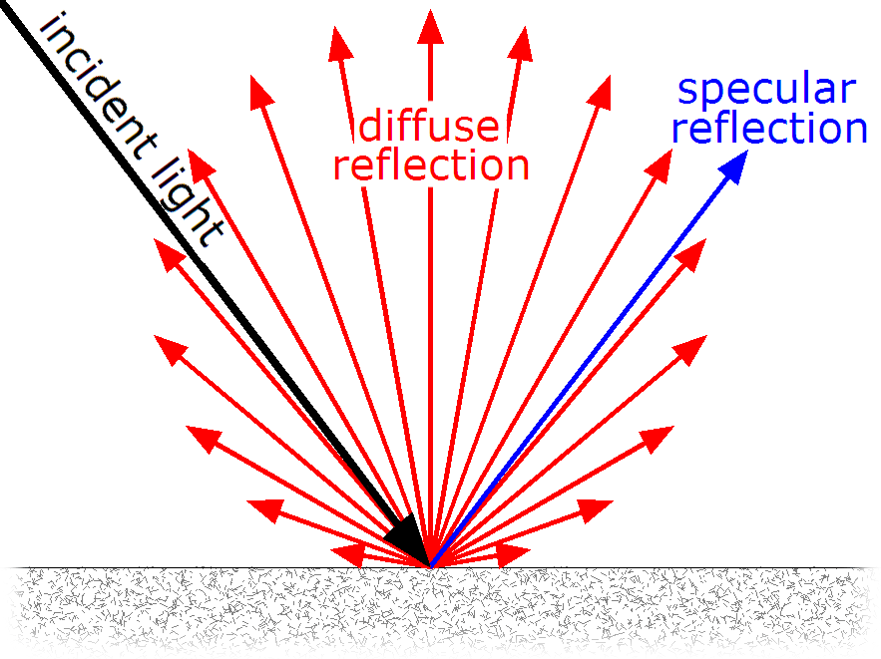
BRDF
Bidirectional Reflectance Distribution Functions
Defines how light is reflected at a surface
Many different BRDF options exist
Each is used for slightly different purposes
PBR uses them to compute diffuse and specular terms

Slide 17
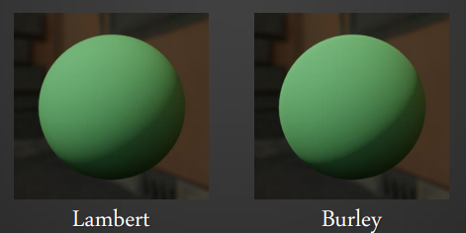
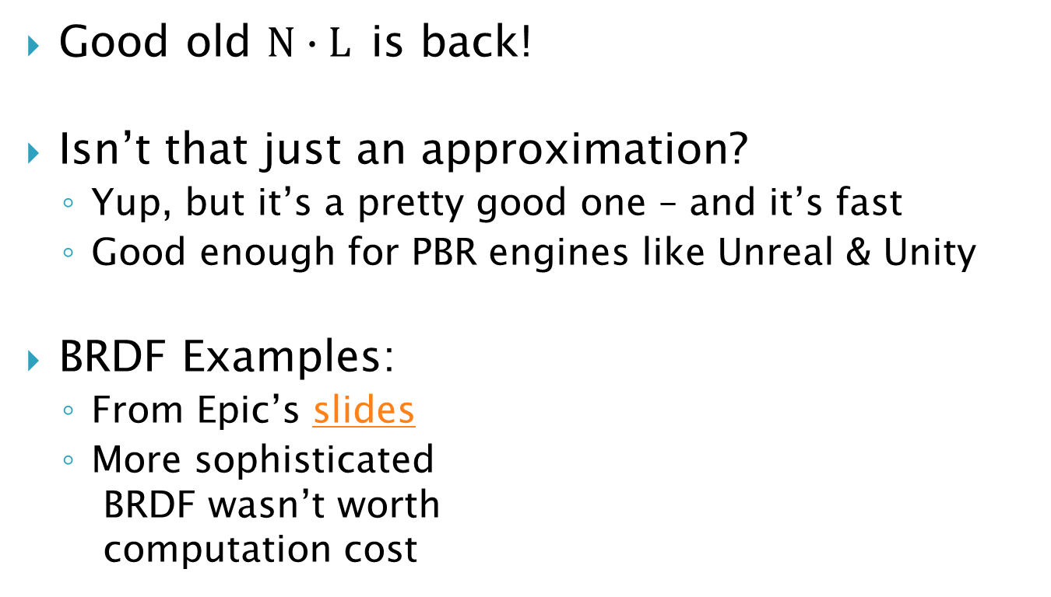
Diffuse BRDF - Lambert
Good old N $∙$ L is back!
Isn’t that just an approximation?
Yup, but it’s a pretty good one – and it’s fast
Good enough for PBR engines like Unreal & Unity
BRDF Examples:
From Epic’s slides
More sophisticated BRDF wasn’t worth computation cost

Slide 18
Specular BRDF - Microfacets
Every surface must account for reflections
But we don’t always want perfect reflections
Some surfaces are rough
Often what we think of as “less shiny”
Rough surfaces actually have “blurry” reflections
In general, everything reflects light
That’s how you can see it
It’s how the light is reflected that matters

Slide 19
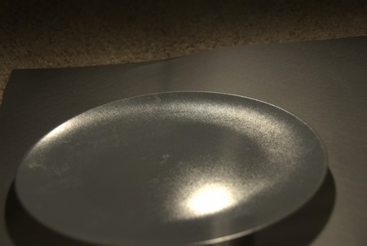
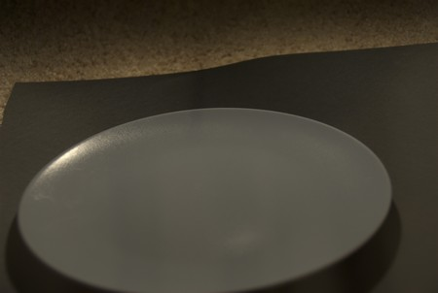
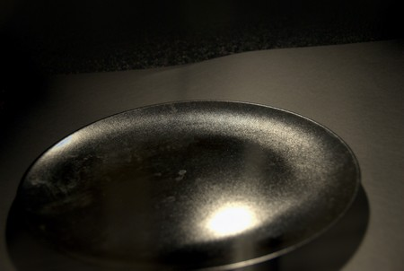
Side Note: Everything is Shiny
Can capture real-world diffuse & specular
With a camera and a light polarizer
Example: An obviously shiny plate
Regular picture
Diffuse Light
Specular Reflection
And everything has Fresnel

Slide 20
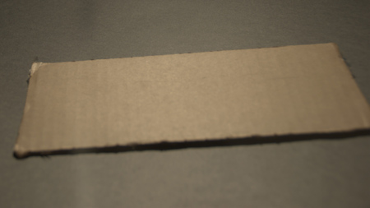
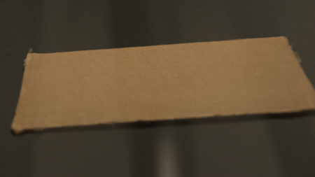
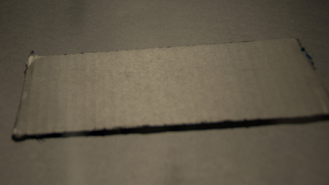
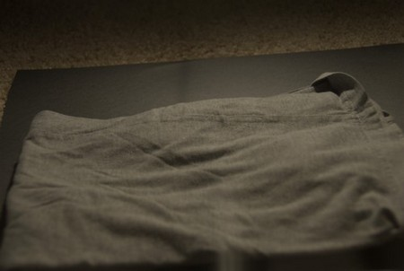
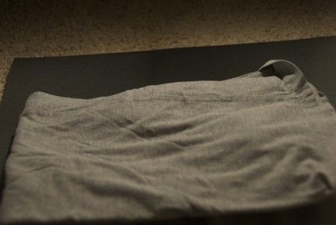
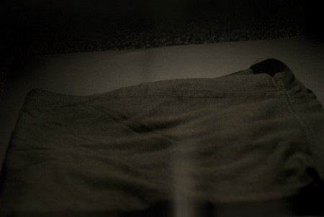
Everything is Shiny – More Stuff
Cardboard is shiny
Cloth is shiny

Slide 21
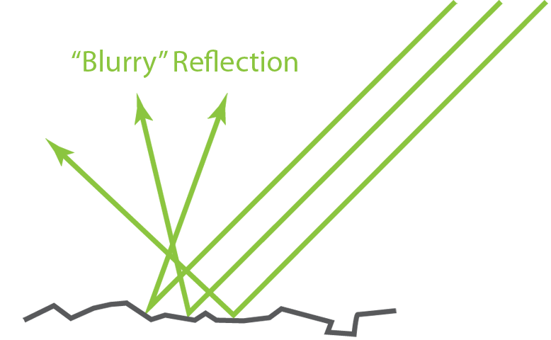
Microfacet theory
Most real surfaces aren’t perfectly smooth
Actually have tiny imperfections which reflect light
Microfacets: Surfaces made up of tiny planes
Each microfacet reflects light
But not all face the camera
Hence blurred reflections
Need to define surface’s overall roughness

Slide 22
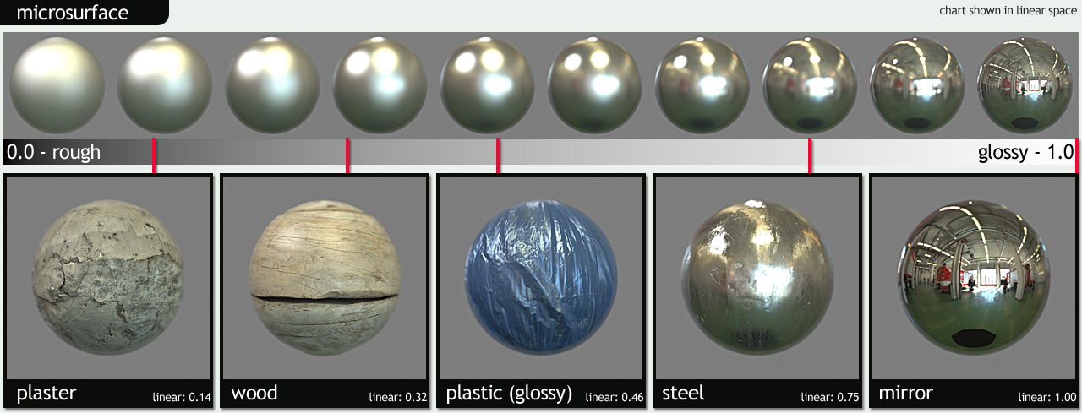
Microfacet examples

Slide 23
Dealing with reflectivity
Roughness determines how blurry the reflection ends up being
Very artist-driven – what does the surface look like?
What about overall reflectivity?
Defining how inherently reflective a surface is
This depends greatly on the type of surface
Very physics-dependent
Controlled through a “metalness” parameter

Slide 24
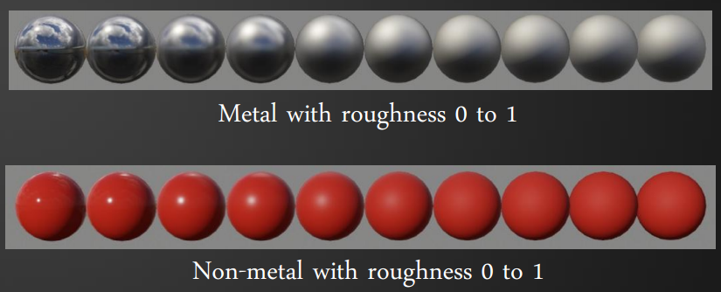
Metalness, huh?
Real-world objects are either:
Metallic – Conductive metals (very reflective)
Dielectric – Plastic, rubber, etc. (less reflective)

Slide 25
Determining metalness
Lots of work has gone into sampling real-world materials, BRDFs, etc.
Quixel Megascans
MERL 100
Mitsubishi Electric Research Laboratories
Captured 100 different material samples
BRDF data available freely online
Disney’s 2012 paper on PBS

Slide 26
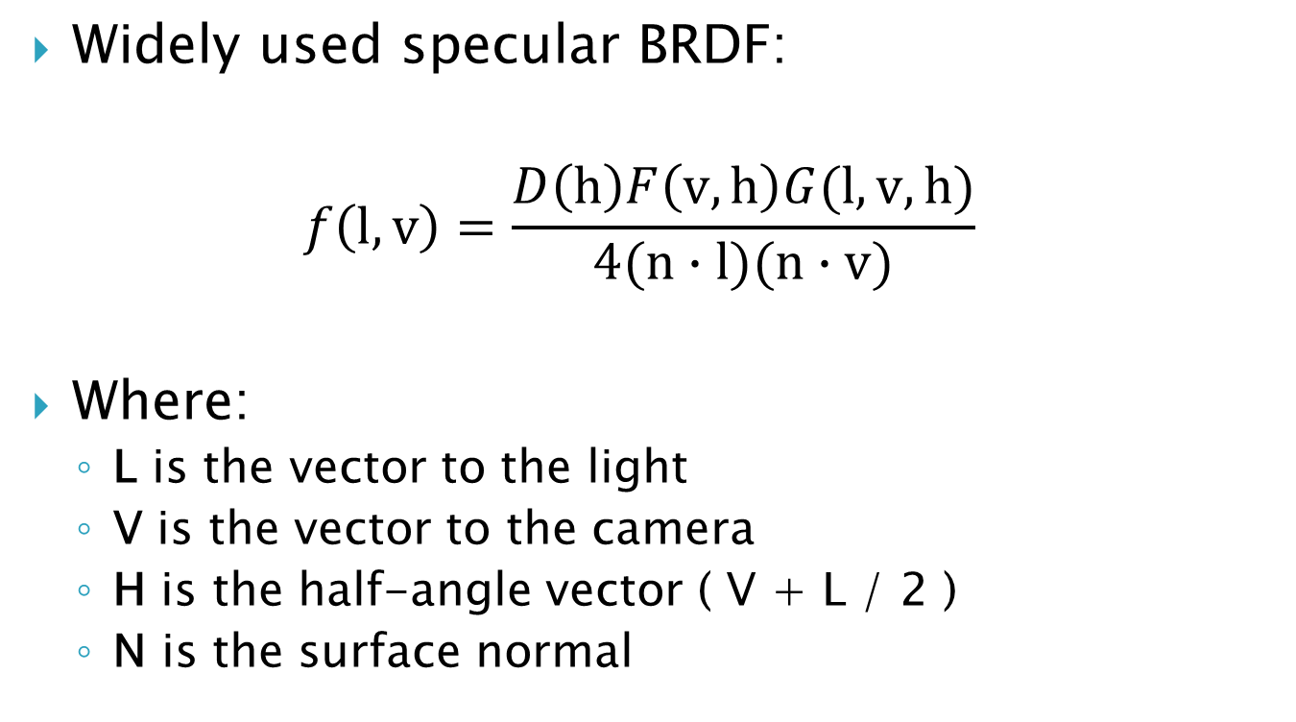
Microfacet BRDF: Cook-Torrance
Widely used specular BRDF:
$$f\left(l,v\right)=\frac{D\left(h\right)F\left(v,h\right)G(l,v,h)}{4(n∙l)(n∙v)}$$
Where:
L is the vector to the light
V is the vector to the camera
H is the half-angle vector ( V + L / 2 )
N is the surface normal

Slide 27
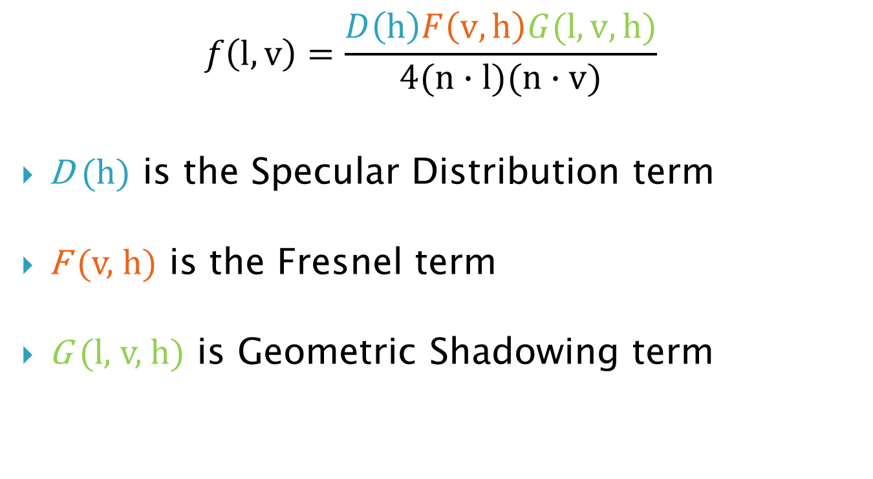
Microfacet BRDF: Cook-Torrance
$$f\left(l,v\right)=\frac{D\left(h\right)F\left(v,h\right)G(l,v,h)}{4(n∙l)(n∙v)}$$
D (h) is the Specular Distribution term
F (v, h) is the Fresnel term
G (l, v, h) is Geometric Shadowing term

Slide 28
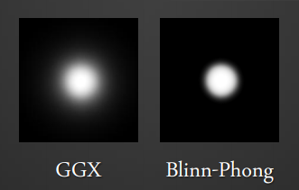
Common Cook-Torrance Functions
D (h) Specular Distribution term
Often Trowbridge-Reitz (GGX)
Looks better than Blinn-Phong
F (v, h) Fresnel term
Schlick approximation – faster, almost identical
G (l, v, h) Geometric Shadowing term
Schlick-GGX, which is an approximation of Smith
Many other options can be found here

Slide 29
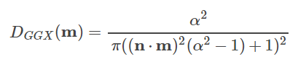
Specular Distribution: D(h)
Also known as Normal Distribution Function
Describes distribution of microfacets
Often Trowbridge-Reitz (GGX)
Looks better than Blinn-Phong
m is the half vector in this case
n is the normal
a is the roughness (often remapped, as per Unreal)

Slide 30
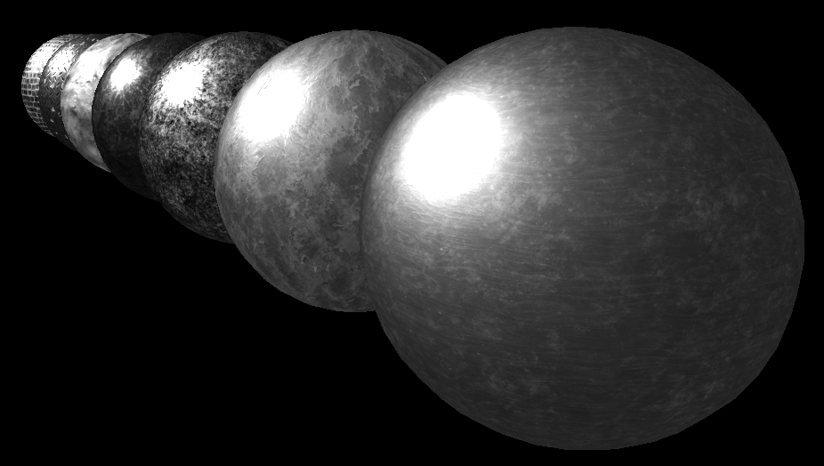
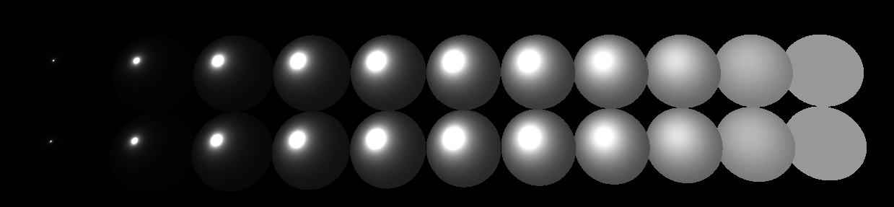
Specular Distribution - Results
Right: D(h) with normal and roughness maps
Below: D(h) with roughness ranging zero to one
Rougher = reflection is more spread out (blurry)

Slide 31
Specular Distribution - Code
float SpecDistribution(float3 n, float3 h, float roughness)
{
// Pre-calculations
float NdotH = saturate(dot(n, h));
float NdotH2 = NdotH * NdotH;
float a = roughness * roughness; // Remap roughness (Unreal)
float a2 = max(a * a, MIN_ROUGHNESS); // Applied after remap!
// ((n dot h)^2 * (a^2 - 1) + 1)
float denomToSquare = NdotH2 * (a2 - 1) + 1;
// Can go to zero if roughness is 0 and NdotH is 1
// Final value
return a2 / (PI * denomToSquare * denomToSquare);
}

Slide 32
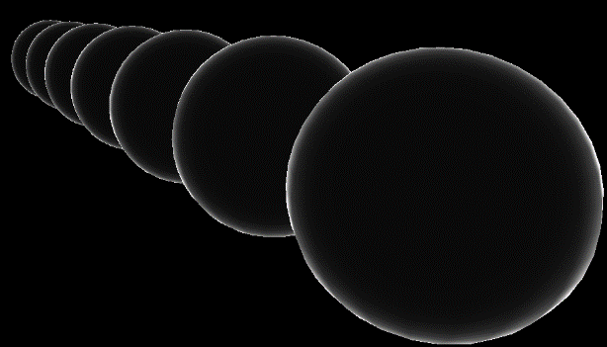
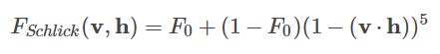
Fresnel: F(v,h)
Describes amount of light that reflects from a mirror surface given index of refraction (IoR)
Schlick approximation
Faster but almost identical
v is view vector (to camera)
h is half vector: (view + toLight) / 2
F₀ is reflectance at normal incidence (0º)
Classic Fresnel based on camera + normal (different from PBR)

Slide 33
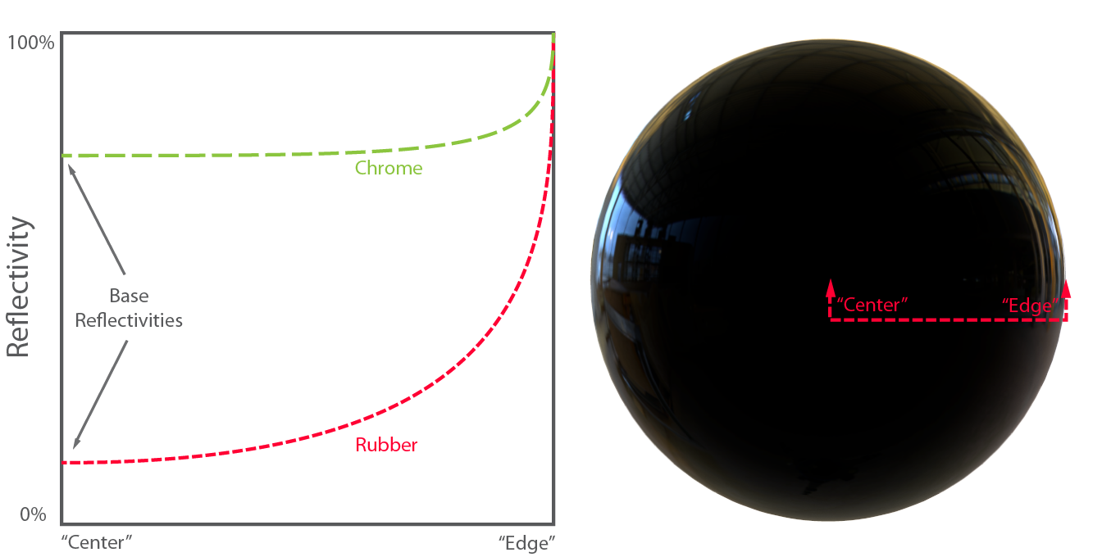
Fresnel example
Everything is reflective, if only at the edge

Slide 34
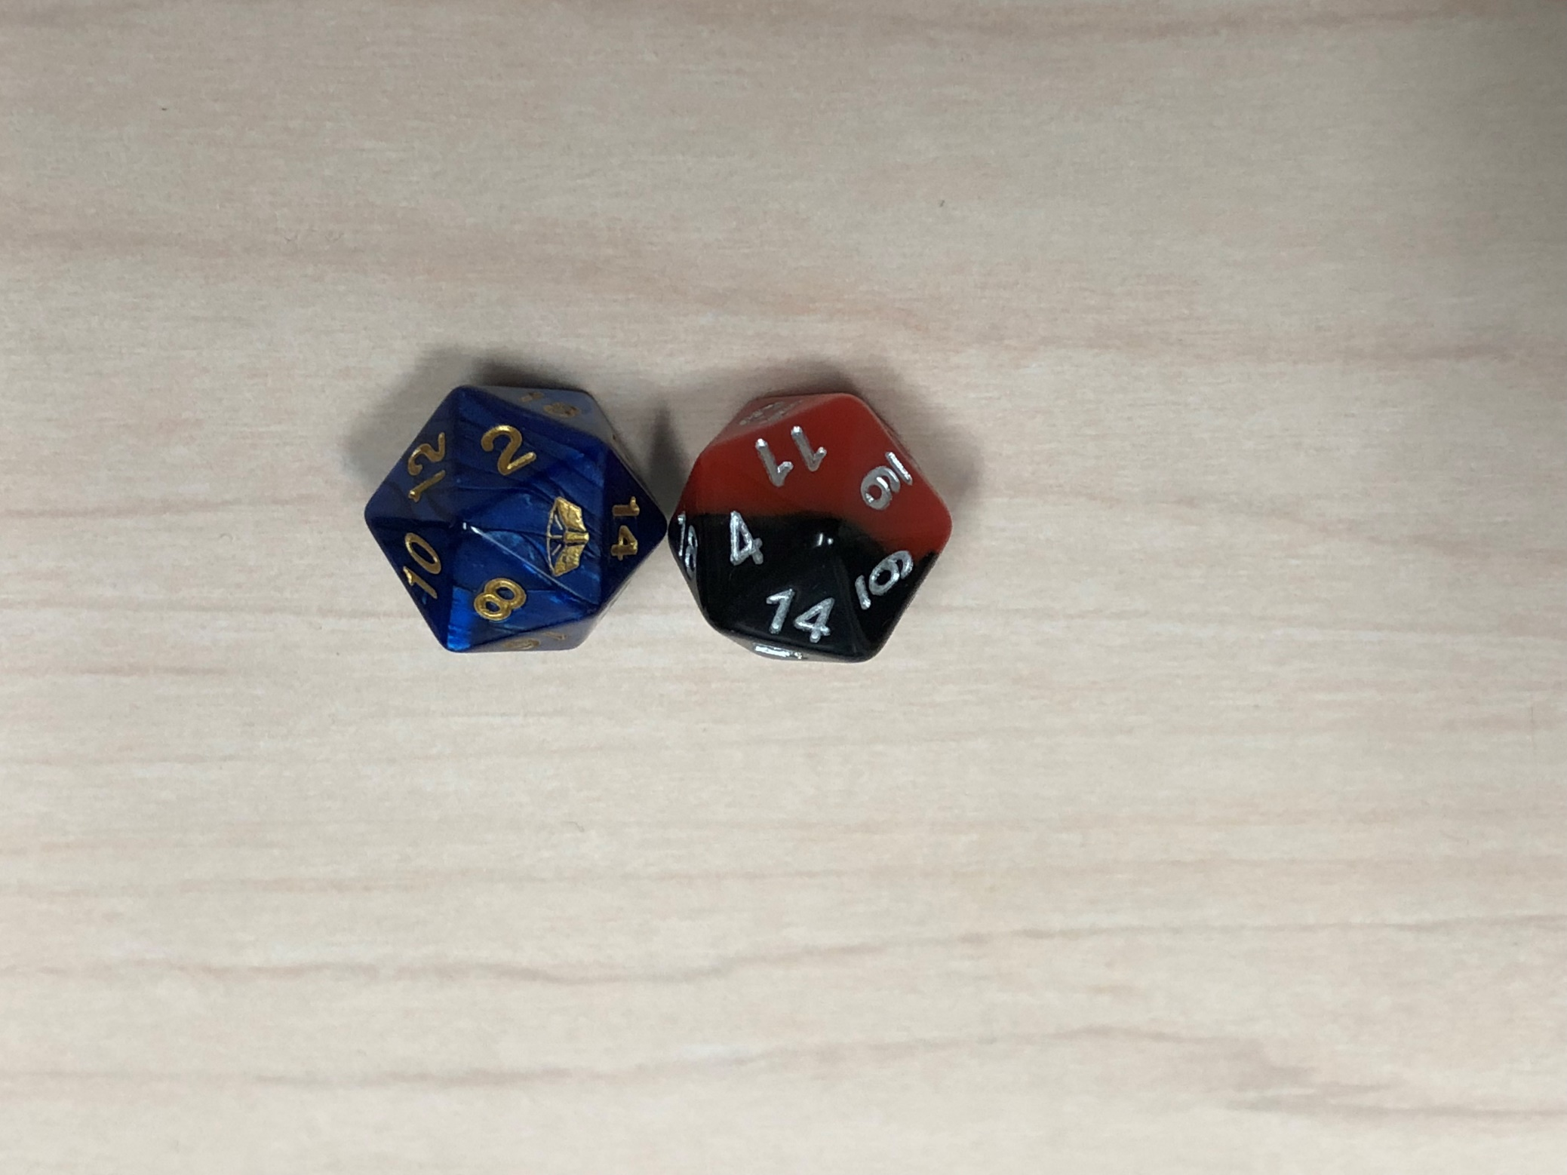
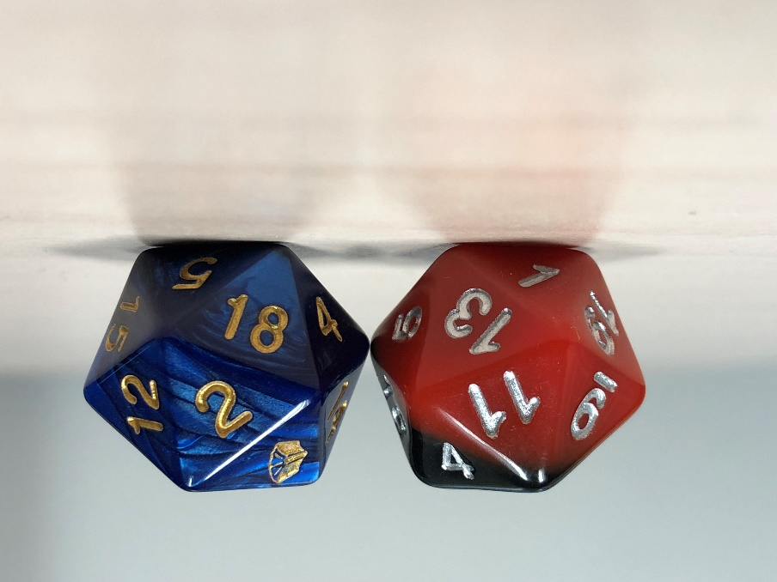
Fresnel example in pictures
Same dice on the same surface from different angles
Notice the reflections at the glancing angle (right)

Slide 35
Fresnel and F₀
F₀ is the reflectance at normal incidence
Assumes light is always hitting head-on (0 degrees)
Where do we get this value? Measure it!
Dielectrics (non-metals):
Glass & plastic are approx. 0.04
Liquids range from 0.02 – 0.04
Gemstones range from 0.05 – 0.17
Conductors (metals):
Have larger ranges that vary per color channel
Often called “specular color” in PBR discussion

Slide 36
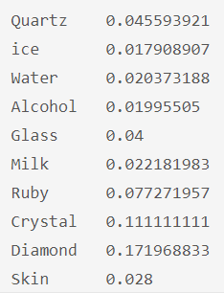
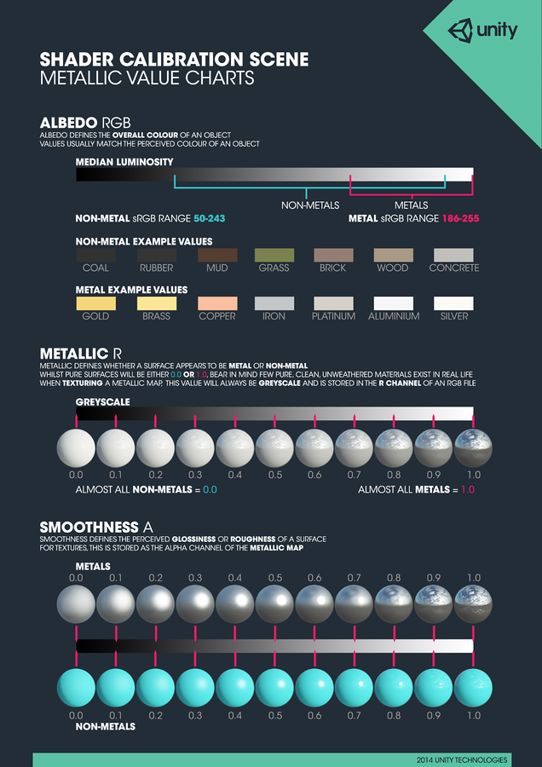
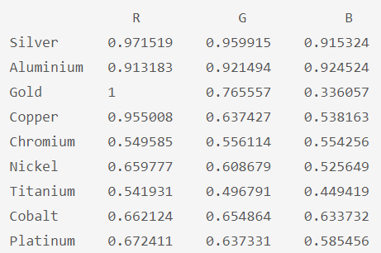
F₀ charts
Companies often make color charts for artists
Found here

Slide 37
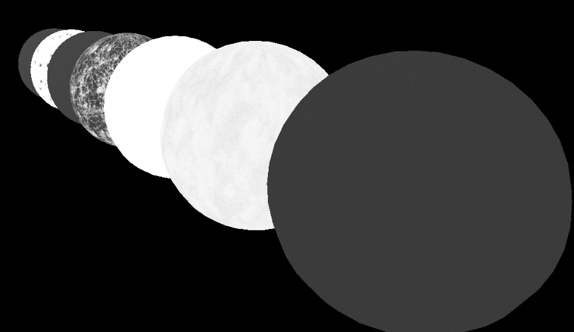
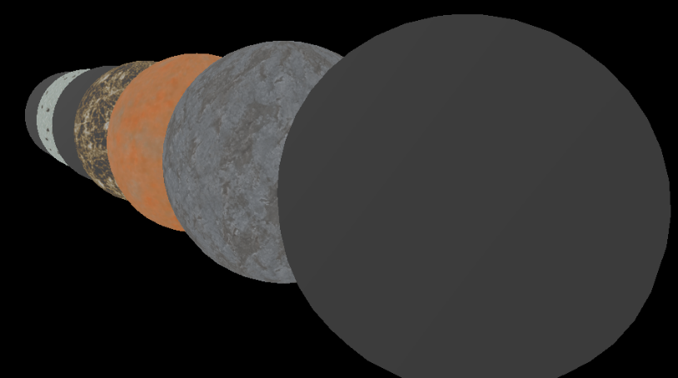
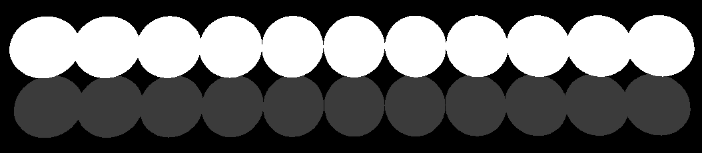
Fresnel - Results
With metalness map
Metalness & spec color
F₀ = (1,1,1) “Silver”
F₀ = (0.04, 0.04, 0.04)
Approximately plastic

Slide 38
Fresnel - Code
// f0 ranges from 0.04 for non-metals to
// a specific specular color for metals
float3 Fresnel(float3 v, float3 h, float3 f0)
{
// Pre-calculations
float VdotH = saturate(dot(v, h));
// Final value
return f0 + (1 - f0) * pow(1 - VdotH, 5);
}

Slide 39
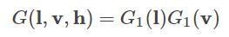
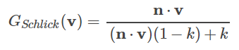
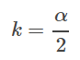
Geometric Shadowing – G(l,v,h)
Describes shadowing from microfacets
Depends on roughness & microfacet distribution
Smith
Breaks G into two parts:
light & view
G1 is Schlick-Beckmann
k depends on roughness
And is remapped as in GGX
Roughness also remapped (Unreal)

Slide 40
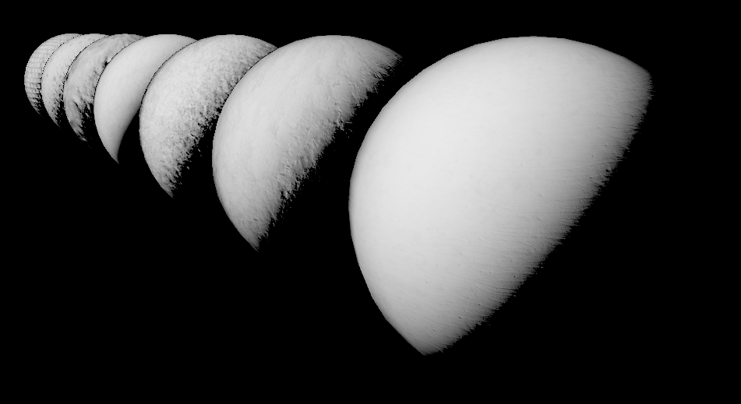
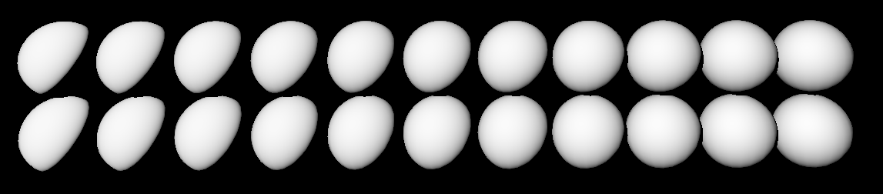
Geometric Shadowing - Results
Right: G() with roughness maps
Below: G() with roughness ranging zero to one

Slide 41
Geometric Shadowing - Code
// k is remapped to a / 2 (a is roughness^2)
// roughness remapped to (r+1)/2
float GeometricShadowing(
float3 n, float3 v, float3 h, float roughness)
{
// End result of remapping:
float k = pow(roughness + 1, 2) / 8.0f;
float NdotV = saturate(dot(n, v));
// Final value
return NdotV / (NdotV * (1 - k) + k);
}

Slide 42
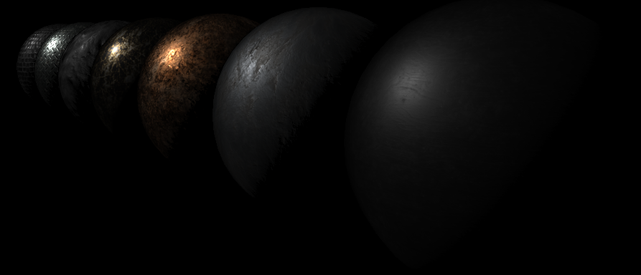
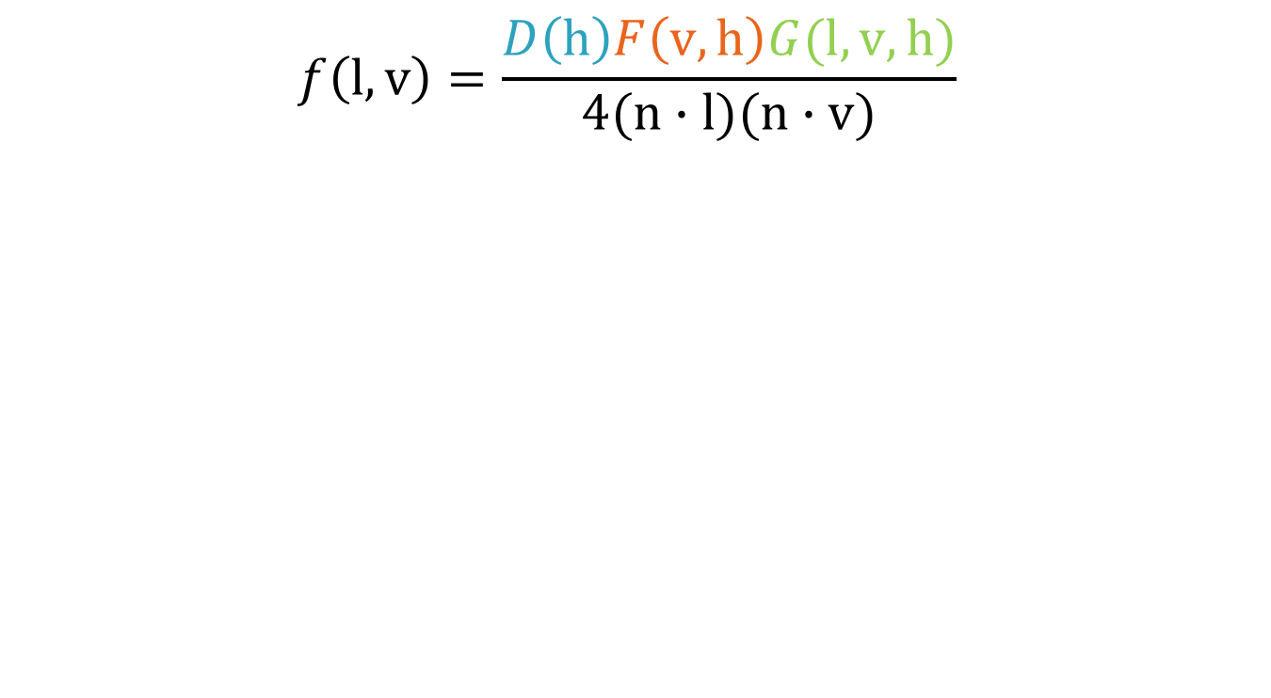
Microfacet BRDF: All together
$$f\left(l,v\right)=\frac{D\left(h\right)F\left(v,h\right)G(l,v,h)}{4(n∙l)(n∙v)}$$

Slide 43
Microfacet – Overall code
// Grab various functions
float D = SpecDistribution(n, h, roughness);
float3 F = Fresnel(v, h, specColor);
float G =
GeometricShadowing(n, v, h, roughness) *
GeometricShadowing(n, l, h, roughness);
// Final formula
// Note: NdotV or NdotL may go to zero!
// Some implementations use max(NdotV, NdotL)
return
(D * F * G) / (4 * max(dot(n,v), dot(n,l)));

Slide 44
Now what?
Combine diffuse and specular terms
So just…
diffuse = Lambert()
spec = MicrofacetBRDF()
final = diffuse * surfaceColor + spec
Nope! That’s too much light!
If light is reflecting, it’s not diffusing
We need to conserve energy

Slide 45
Energy conservation
Once you have your lighting terms
Direct Diffuse
Direct Reflection
Indirect Diffuse
Indirect Reflection
They must be combined
In such a way that extra energy is not created
Article on Energy Conservation in Games

Slide 46
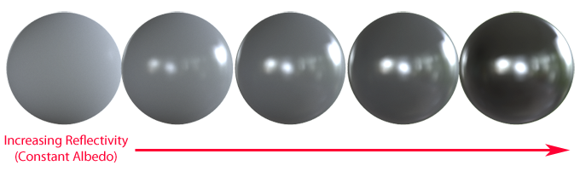
Energy conservation example
More reflection = less diffusion

Slide 47
Conserving energy - Code
// Calculates diffuse color based on energy conservation
// Note: metals should have an albedo of approx.
// (0,0,0), so take metalness into account here!
float3 DiffuseEnergyConserve(
float diffuse, float3 specular, float metalness)
{
return
diffuse *
((1 - saturate(specular)) * (1 - metalness));
}

Slide 48
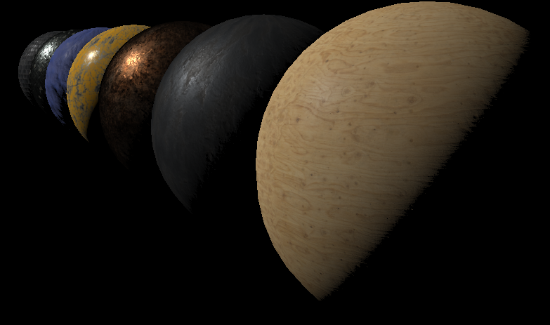
PBR: Diffuse + Specular (balanced)

Slide 49
Indirect PBR

Slide 50
What are we reflecting?
Direct Light
Light from individual light sources
(This is what Cook-Torrance helped us with)
Indirect Light
Light bouncing around the scene
A simple “global illumination” approximation
How do we determine the indirect light?
And how do we handle blurry reflections?

Slide 51
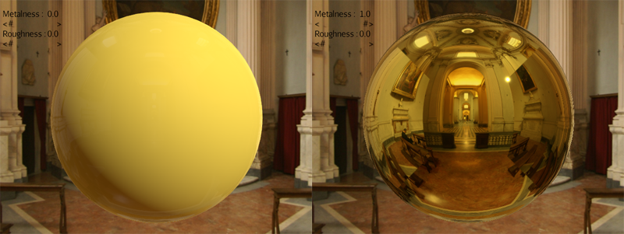
Indirect reflections
We’ve been using a cube map for reflections
Skybox cube map = reflections
Use the same cube map for indirect lighting!
Treat the cube map as a light source
Light is coming from everywhere in the scene

Slide 52
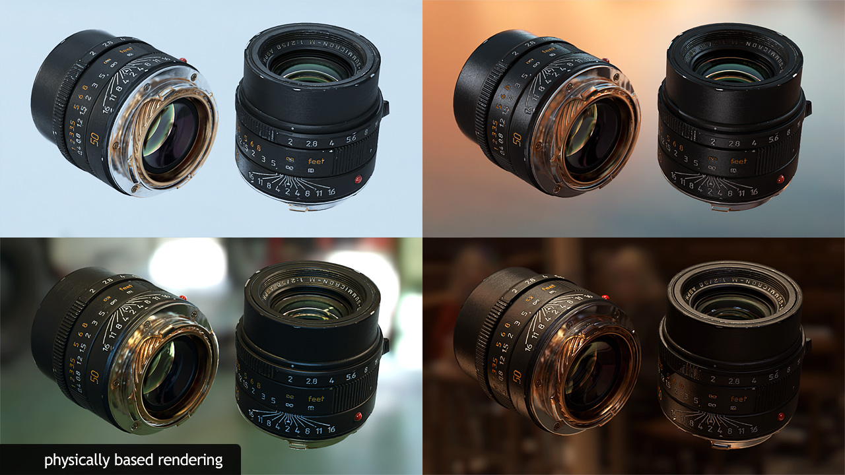
Image based lighting: Example
Environment map
Used as light source, in addition to actual lights
Objects look good (correct) in any environment

Slide 53
IBL: Lots of light
Wait, if light is coming from everywhere
Then each pixel of the cube map is a light source?
128x128x6 cube map has almost 100K pixels
Even if we only use half (one side of our object)…
That’s a lot of lights to process!
What we need is an irradiance map
A cube map with precomputed light information
Light coming into a pixel

Slide 54
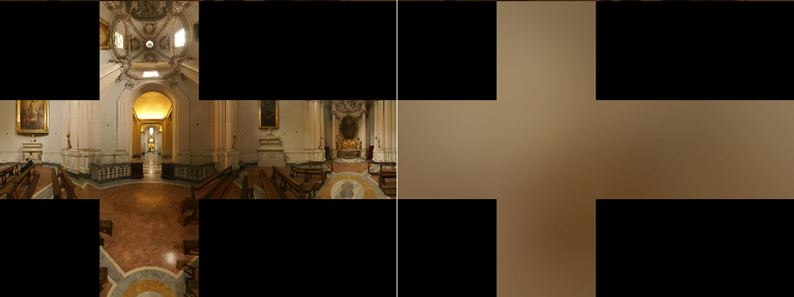
Indirect Diffuse: Irradiance map
For each direction in space, we need to…
Sample in a hemisphere oriented in that direction
Calculate a weighted average of all those samples
Seems like overkill, but can be done!
At start up
Or “bake it” offline and load the results
Created from environment map

Slide 55
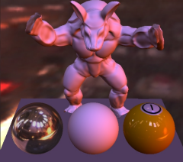
Alternatively: Spherical Harmonics
A series of functions on a sphere used to solve some differential equations
For PBR systems:
A way to calculate a very accurate irradiance map
With only 9 SH coefficients
Articles on SH:
SH for beginners
SH for environment maps

Slide 56
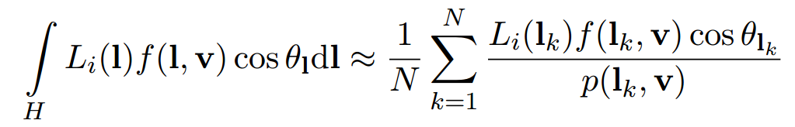
Indirect Specular: Reflections
Perfect reflections are easy: Sample cube map
What about blurry reflections?
If you want to use microfacet BRDF
With image-based lighting…
Need to solve the radiance integral:

Slide 57
Radiance integral
Too expensive to calculate perfectly
Can be estimated with importance sampling
Estimates properties of a particular distribution
By taking evenly distributed samples
However, MANY samples still required!
1024 is good
4096 is better

Slide 58
Radiance integral estimation
We often blend between multiple cube maps
Especially for localized reflection probes
Or blended skyboxes
More than one sample per map is unfeasible
What if we pre-calculate the work?
Works great if environment map doesn’t change
What would this take?
And how do we deal with blurry reflections?

Slide 59
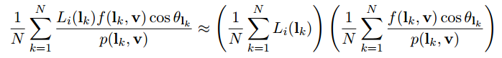
Split Sum Approximation
The sum can be split into two parts
Each part can be pre-calculated
1. Pre-Filtered Environment Map
2. Environment BRDF

Slide 60

Split Sum: Environment Map
Pre-calculate the first sum for various roughness values
Store each result in a different mip level
When sampling:
Use the most appropriate mip level for desired blurriness

Slide 61

Split Sum: Environment BRDF
A 2D look-up texture
Based on different roughness values
Actual values stored are a scale & bias to Fresnel
OpenGL
uv(0,0) = bottom left
DirectX
uv(0,0) = top left

Slide 62
Energy Conservation
Once you have your lighting terms
Direct Diffuse
Direct Reflection
Indirect Diffuse
Indirect Reflection
They must be combined
In such a way that extra energy is not created
Article on Energy Conservation in Games

Slide 63
What about some code?
LearnOpenGL.com has a great overview of the theory and code of PBR:
https://learnopengl.com/#!PBR/Theory
https://learnopengl.com/#!PBR/Lighting
IBL: How to make required env. assets
https://learnopengl.com/#!PBR/IBL/Diffuse-irradiance
https://learnopengl.com/#!PBR/IBL/Specular-IBL
Also refer to the demo on MyCourses!

Slide 64
Other useful resources
SIGGRAPH 2013 course on PBS
PBR Theory and Practice from Marmoset
Focused on artists
Slides and Paper about Unreal’s PBS system
Articles from a dev at DICE about adopting and then feeding a PBS system
3-Parter about PBR in the jMonkeyEngine: 1 2 3

